Slide 1



NEW LIFE TO THE
—— FUTURE
Campus Mutual Assistance
Integrated Platform
Team Name：overload
Course：EE308FZ
2025/11/26
NEW PRODUCT LAUNCH
演讲人：Yiqi Fan

Slide 2

CONTANTS
1
2
3
4
5
Background
&
Pain Points
Approach
&
Method
Interface Prototype Design
Function Demonstration
Deployment

Slide 3


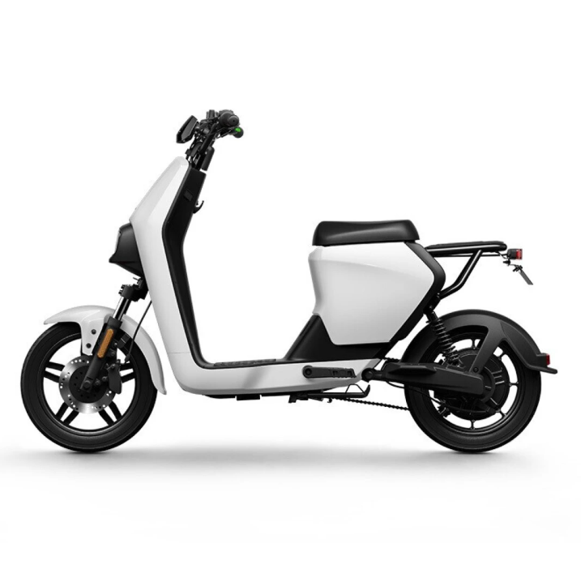




01
Background & Pain Points
Fragmented channels:
Second-hand trade information is scattered across social media with no trust guarantee.
Inefficient errand requests:
Students cannot quickly find helpers for short-term tasks or purchases.
Survey data snippet like “Over 70 % of students reported difficulty finding reliable campus services.”
Unsafe carpool communication:
No identity verification or clear pickup locations.
Core Need:
A centralized campus platform ensuring trust, efficiency, and safety in daily mutual help.

Slide 4



1
Background & Pain Points
Transaction Success Rate$≥85\%$
Active user coverage$≥60\%$
Benefits—Quantitative Metrics
Average Response Time Reduced by $30\%$
01
02
03
User
Campus
☑ Save time searching for information and connecting with others, improving overall efficiency.
Team
☑ Encourage the reuse of idle resources and reduce material waste.
☑ Enhance members’ technical skills in full-stack development, database management, and system integration.
☑ Build a stronger sense of mutual support and community connection among students and staff.
☑ Strengthen trust and safety through real-name authentication and a user rating system.
☑ Cultivate teamwork, communication, and project management abilities.
☑ Improve information flow and campus convenience, forming a sustainable and trustworthy service ecosystem.
☑Integrated services (trading, errands, carpool) reduce the need to switch between multiple apps.
☑ Serve as a foundation for future competitions, academic presentations, or publications.
☑ Provide valuable user data insights for school administrators to enhance future digital campus services.
☑Real-time order tracking and feedback provide a smoother user experience.
☑ Establish a reusable campus service platform framework for continuous innovation.

Slide 5


02
Approach & Method
Goal: A comprehensive platform integrating second-hand transactions, campus errands, and carpooling.
Technology Stack: Front-end & Back-end separation + Database + Authentication + Order Tracking + Evaluation System.
Stage1: Publishing and Browsing
User
Stage2: Order and Payment Simulation
Frontend
Backend
Stage3: Carpool and Rating System
Database
Stage4: Trial and Feedback Optimization
Payment Module

Slide 6
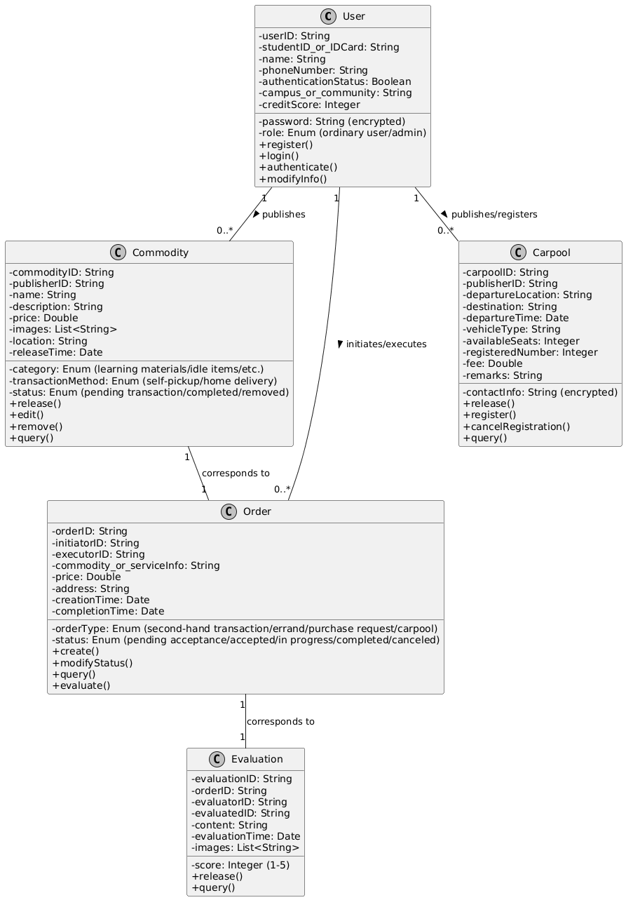
02
Approach & Method

Slide 8
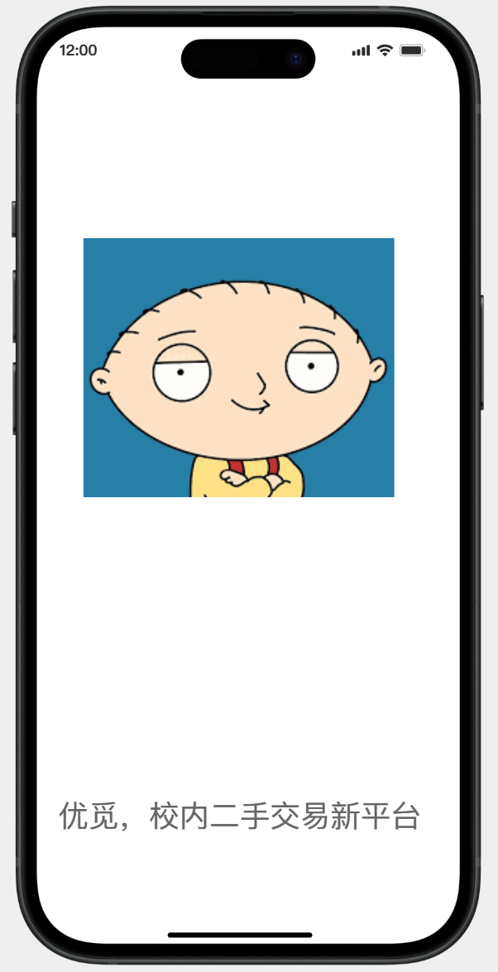
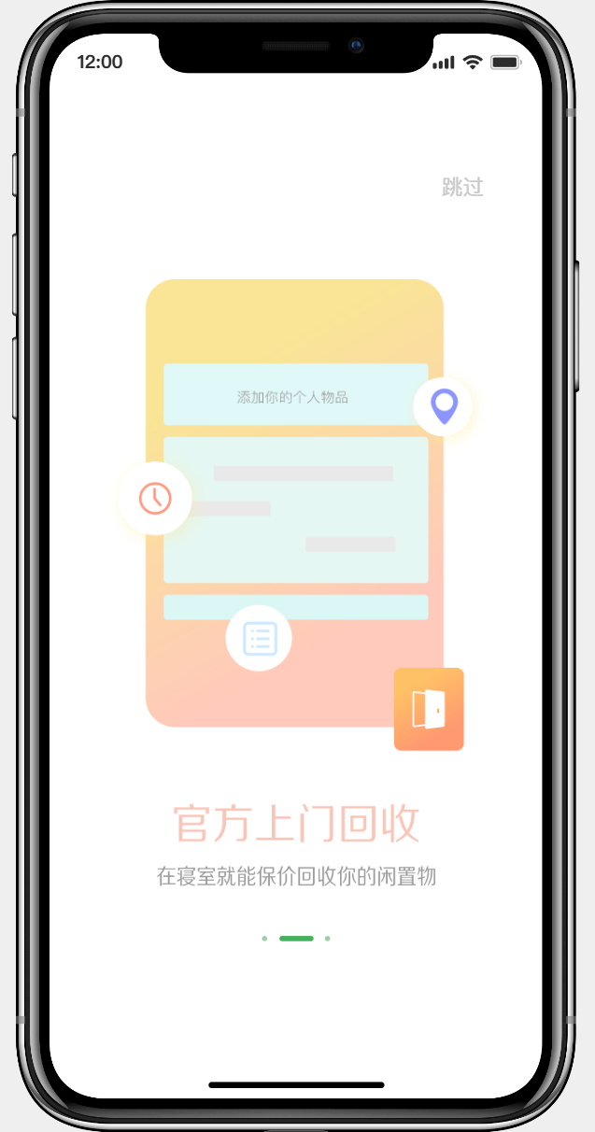
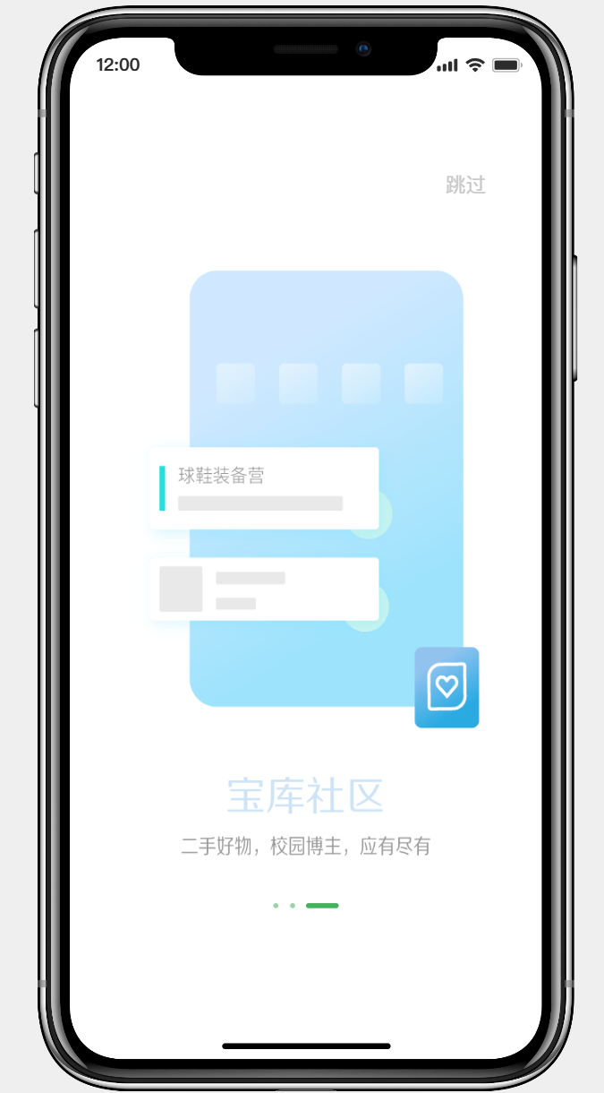
03
Interface Prototype Design
Launch Screen
This slide showcases the launch screens for the three core modules of the "Umi" platform.
Together, these interfaces define the system's main functionalities and user journey, providing a direct foundation for the subsequent Class Diagram, detailed feature description, and acceptance criteria.

Slide 9
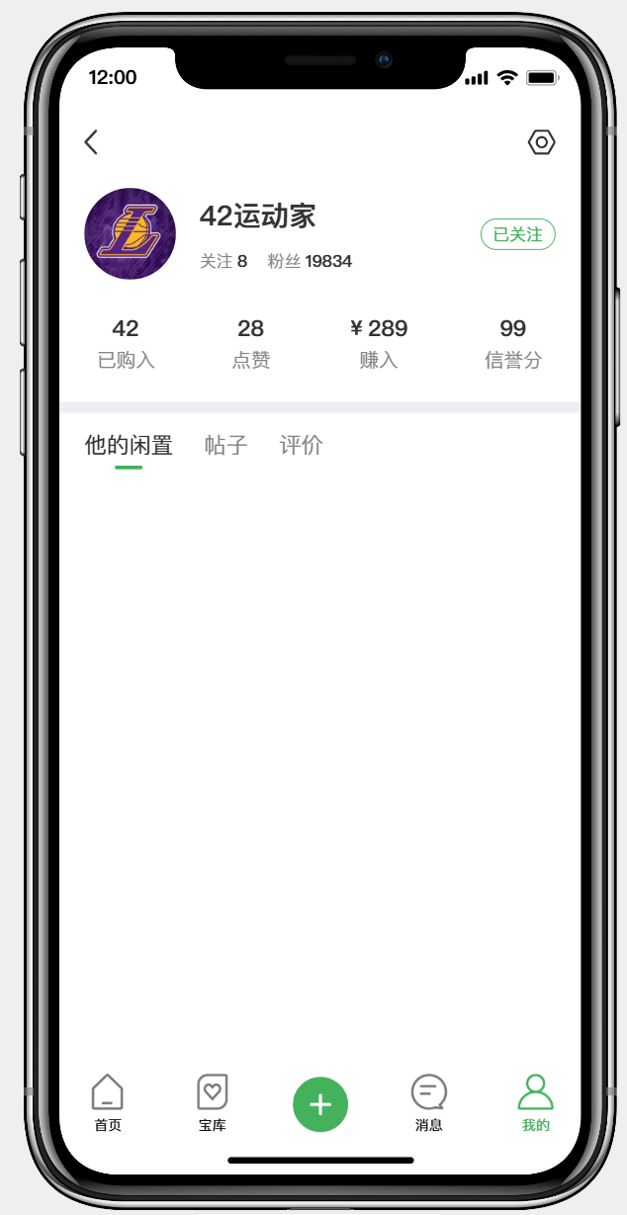
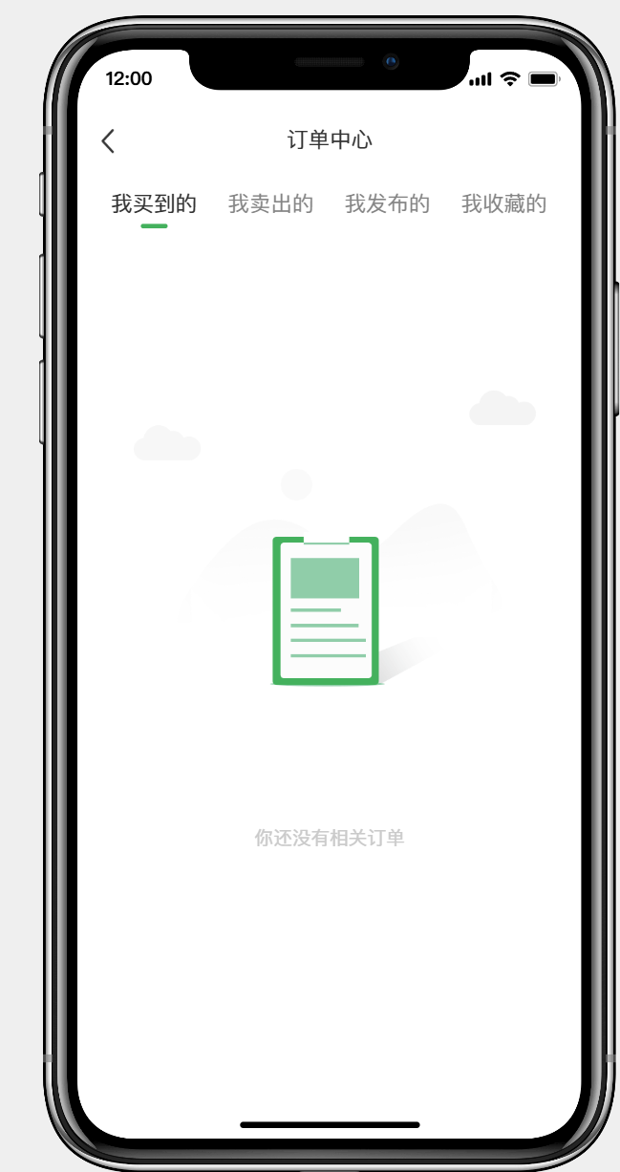
03
Interface Prototype Design
Home Screen
This slide presents the user's personal space and transaction management core modules. The left "User Homepage" focuses on building trust by displaying the user's credit score and community influence (follower count). The right "Order Center" manages the entire transaction lifecycle (bought, sold, published, favorites) with clear categorization, demonstrating the platform's design for comprehensive order management.

Slide 10
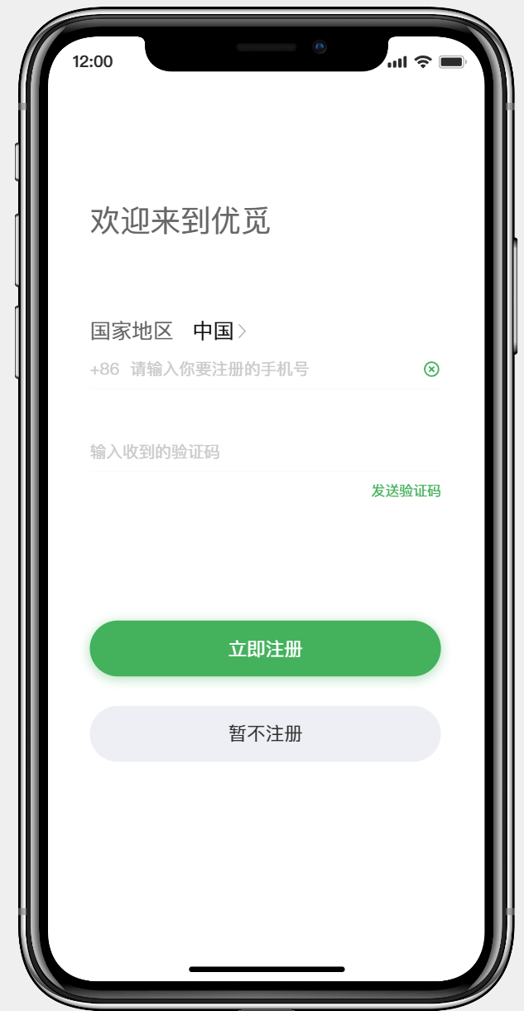
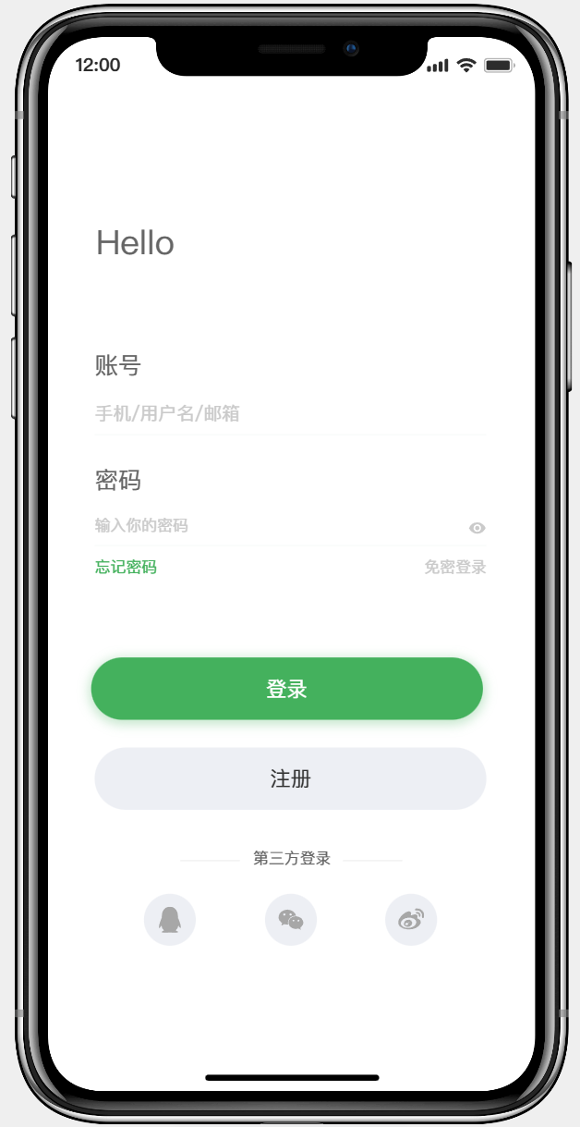
03
Interface Prototype Design
Authentication Screen
This is the design for the platform entry point. The left Chinese registration interface uses a "mobile number + SMS verification" method, balancing security and convenience, with a "Register Later" option to reduce barriers. The right international login interface supports multiple account formats, password-free login, and social logins, showcasing a flexible authentication strategy for a diverse user base.

Slide 11
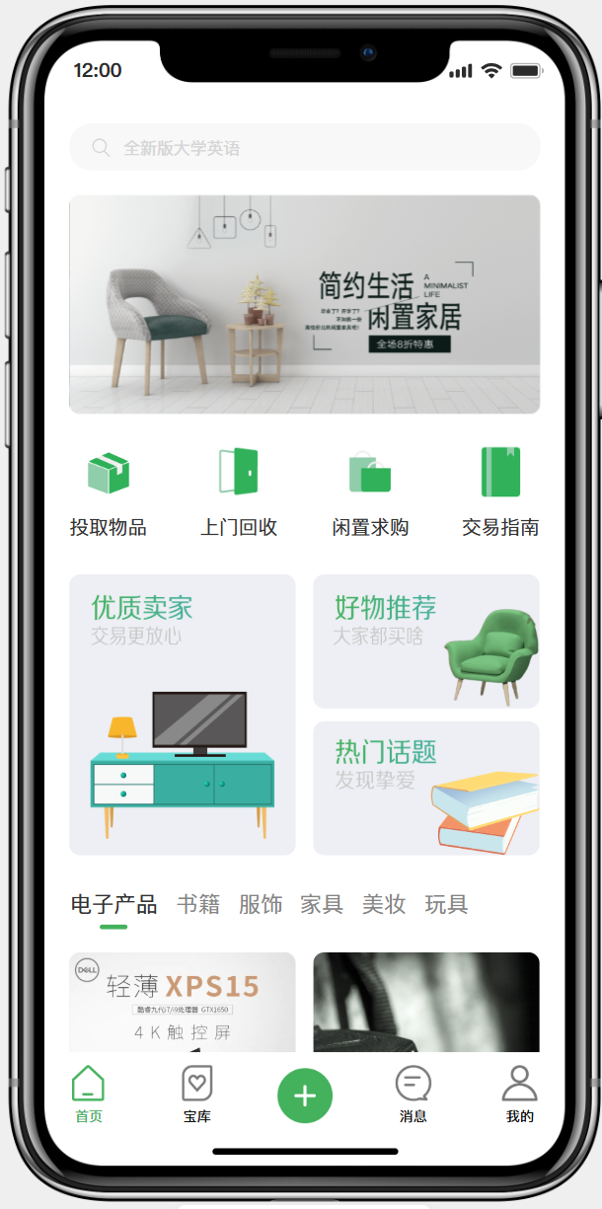
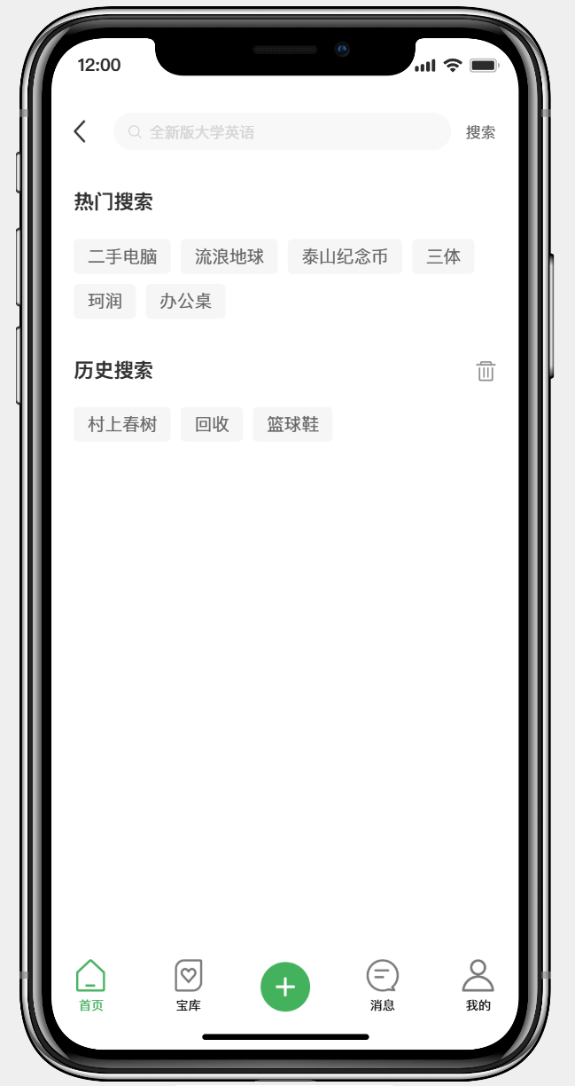
04
Function Desmonstration
Main Screen and Search Feature
The main interface integrates core service gateways, personalized recommendations, and intelligent search. The top search bar acts as a functional hub; buttons like "On-site Recycling" direct to key services; "Quality Sellers" and "Recommendations" leverage community data to drive decisions. The search page enhances discovery efficiency through "Trending" and "History" suggestions.

Slide 12
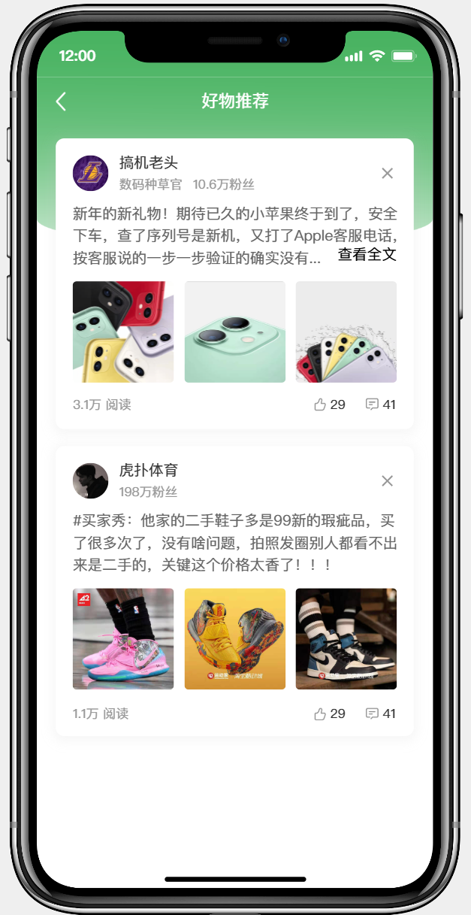
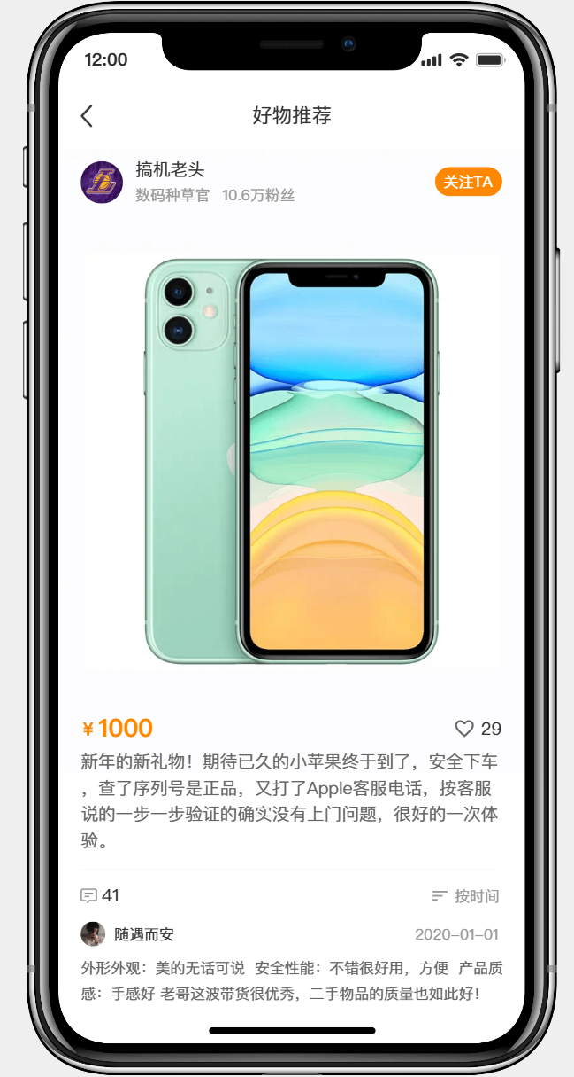
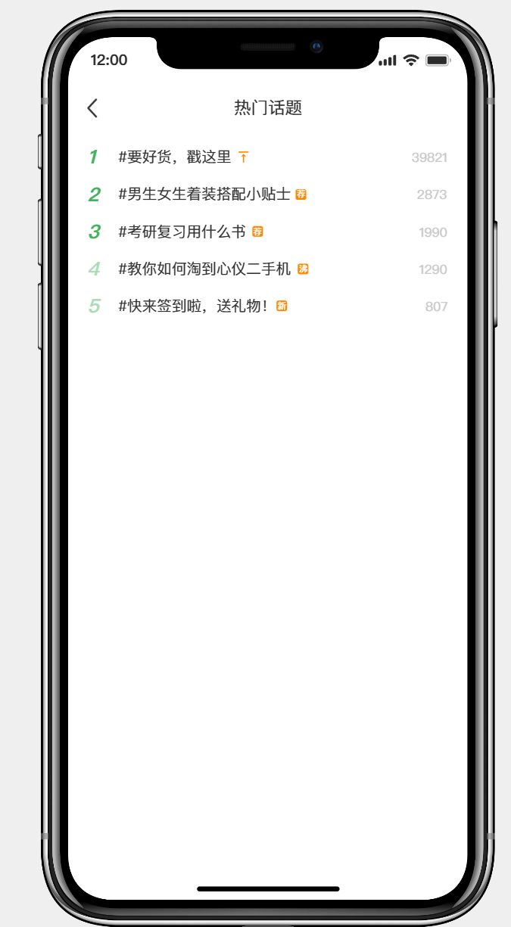
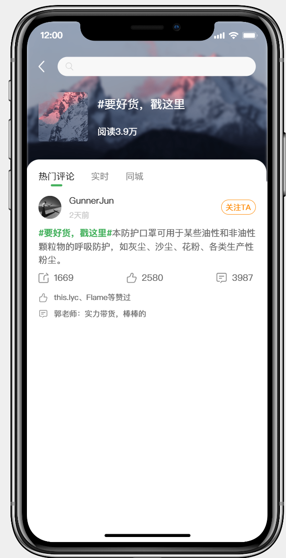
04
Function Desmonstration
Product Recommendations
& Trending Topics
This design highlights the platform's community and content ecosystem. It simulates authentic User-Generated Content like "buyer shows" and unboxing shares, boosting credibility and engagement. The trending topics list creates scenario-based consumption needs, efficiently converting traffic into transactions.

Slide 13
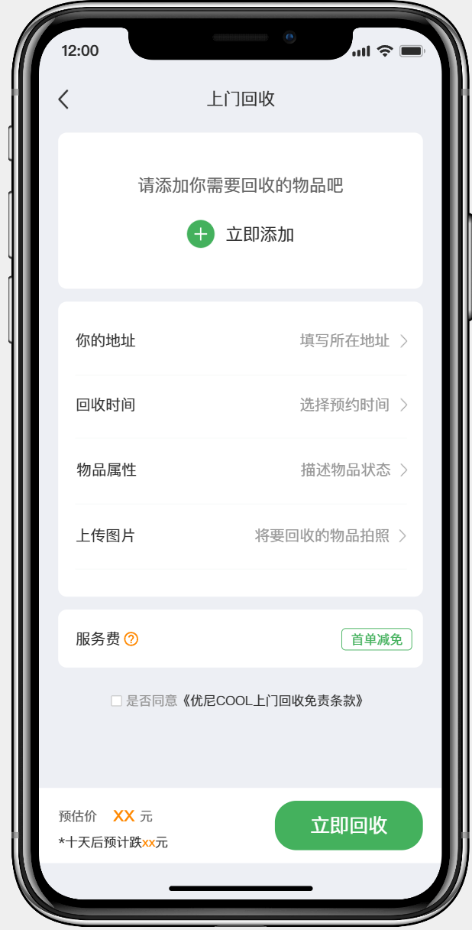
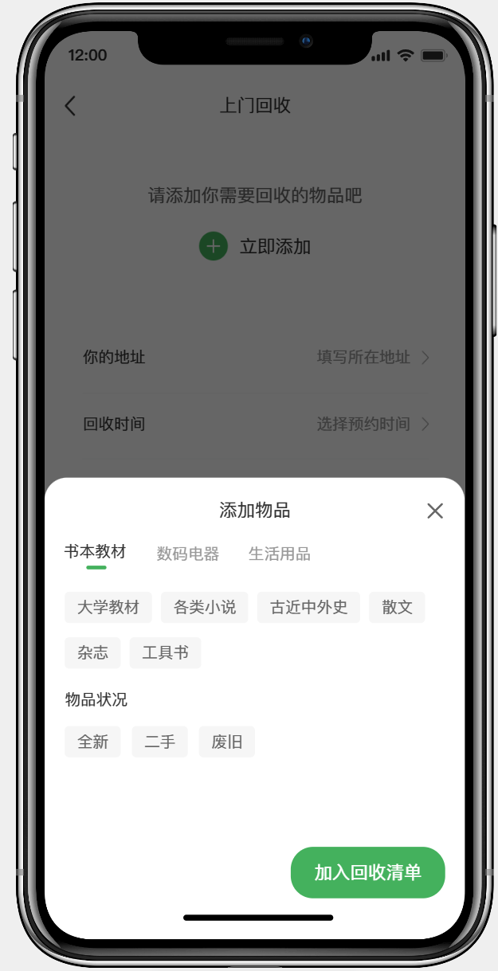
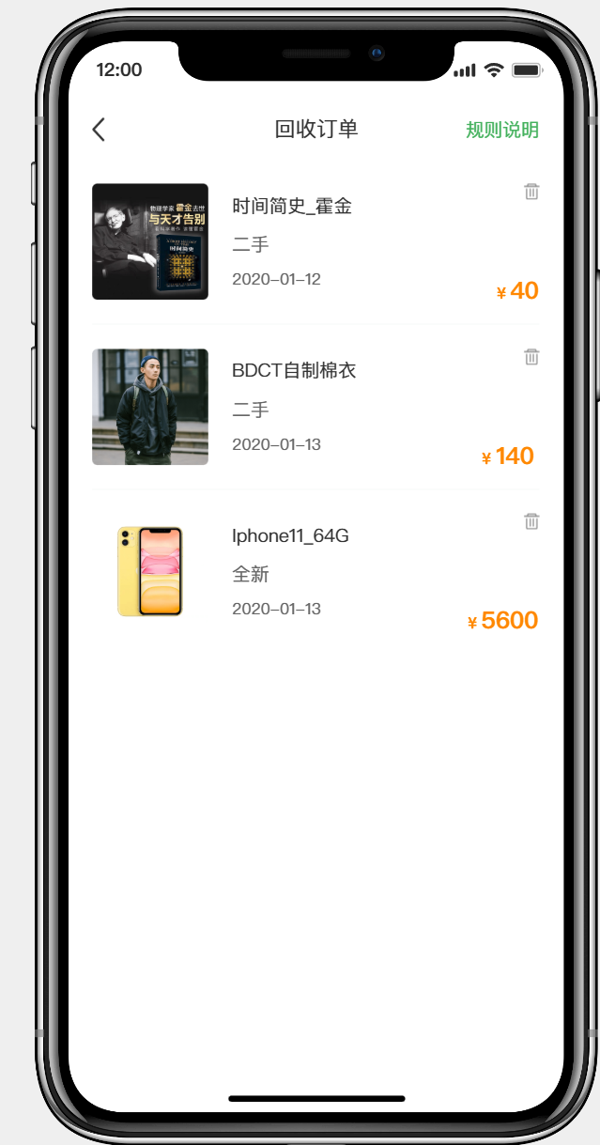
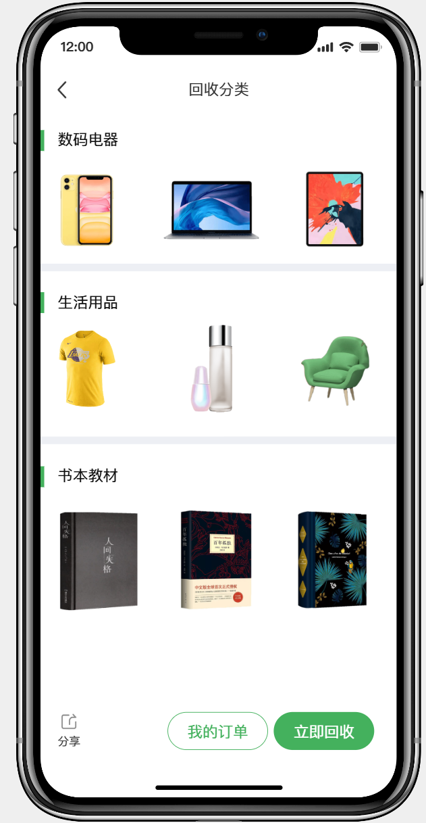
04
Function Desmonstration
Product Return Screen
This flow clearly demonstrates the distinctive "On-site Recycling" service. From adding items, describing condition, scheduling pickup to generating a price estimate, each step is designed to simplify user actions. Transparent display of "Service Fees" and "Terms" shows clear rule design, while the "Price Estimate" feature enhances service predictability.

Slide 14
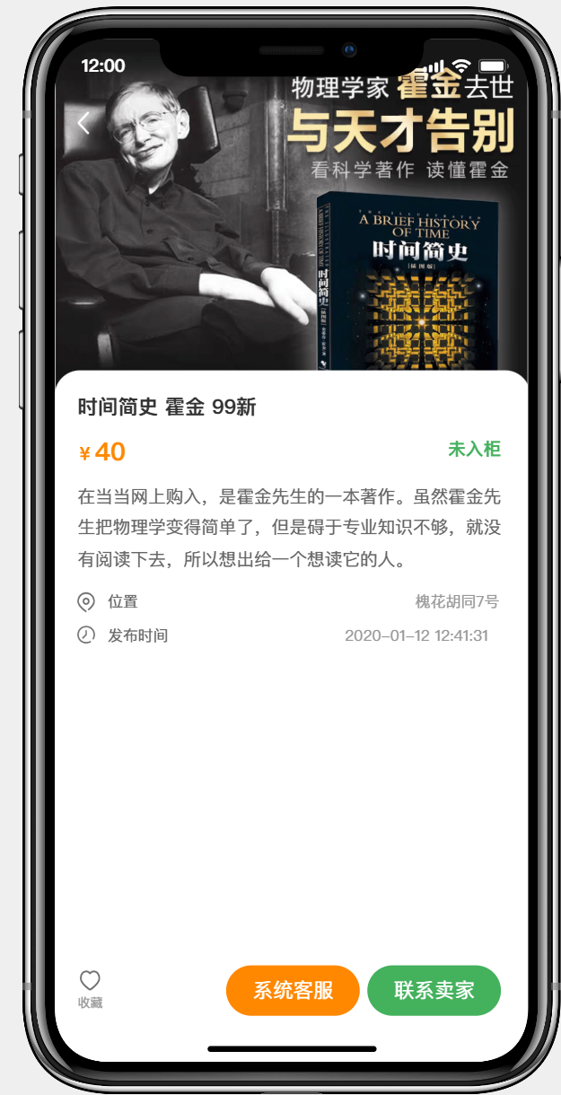
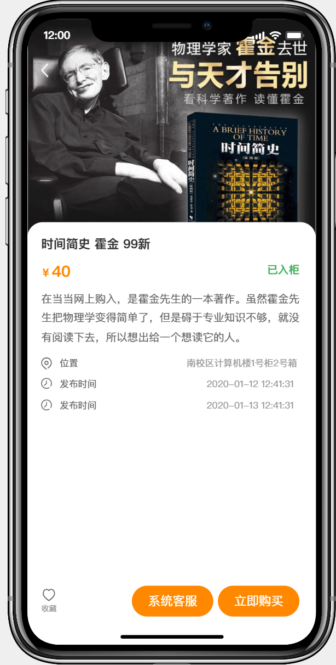
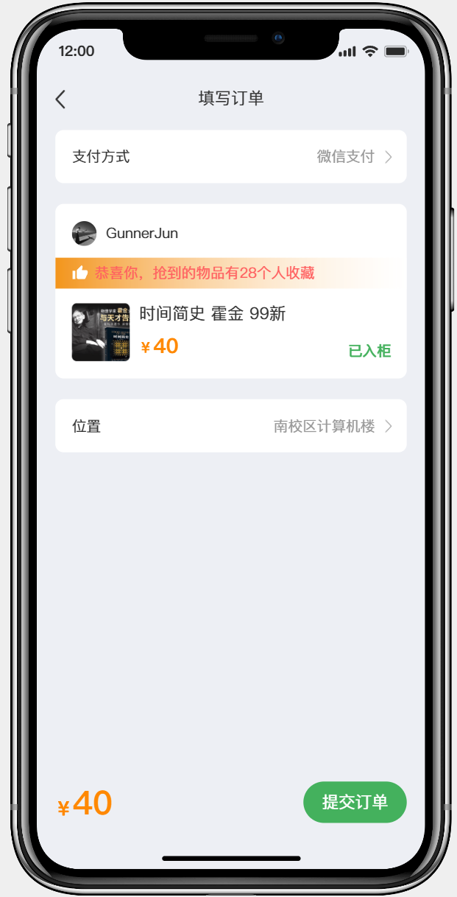
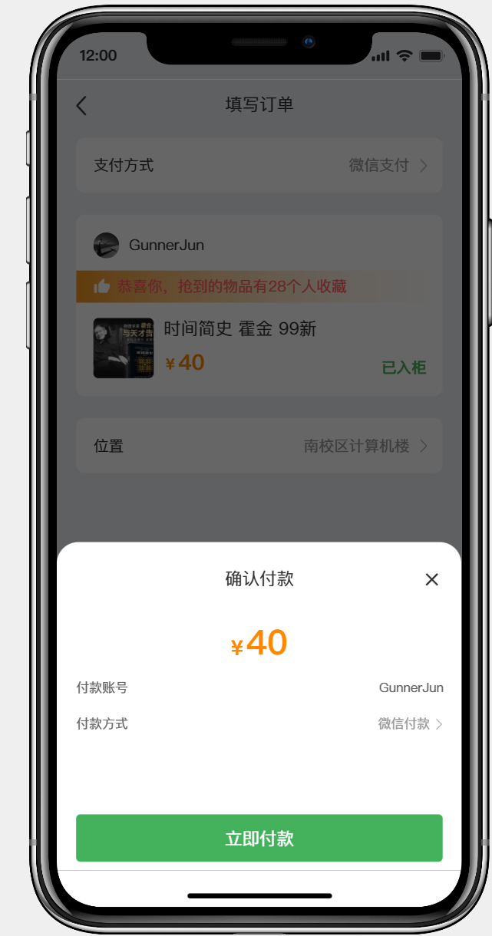
04
Function Desmonstration
Product Detail Page
The product detail page is crucial for converting interest into transactions. The layout is hierarchical: top section for visuals and key information, middle for seller info and interaction, and a clear call-to-action ("Buy Now") at the bottom. This design effectively guides users through the decision-making path from browsing to purchasing.
Unlisted
listed

Slide 15
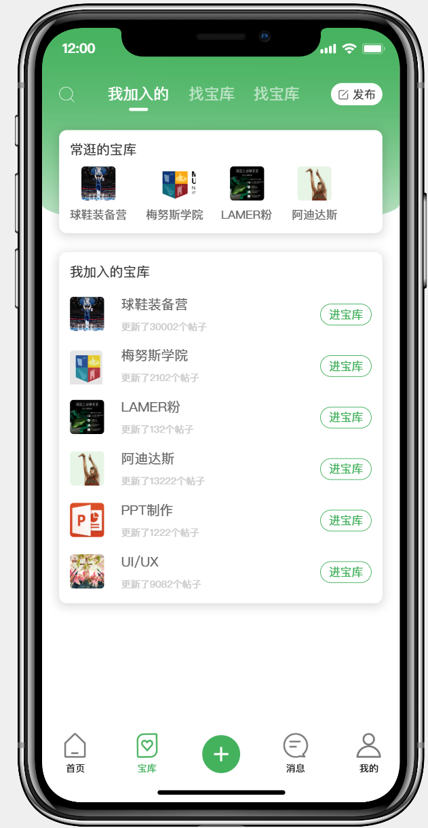
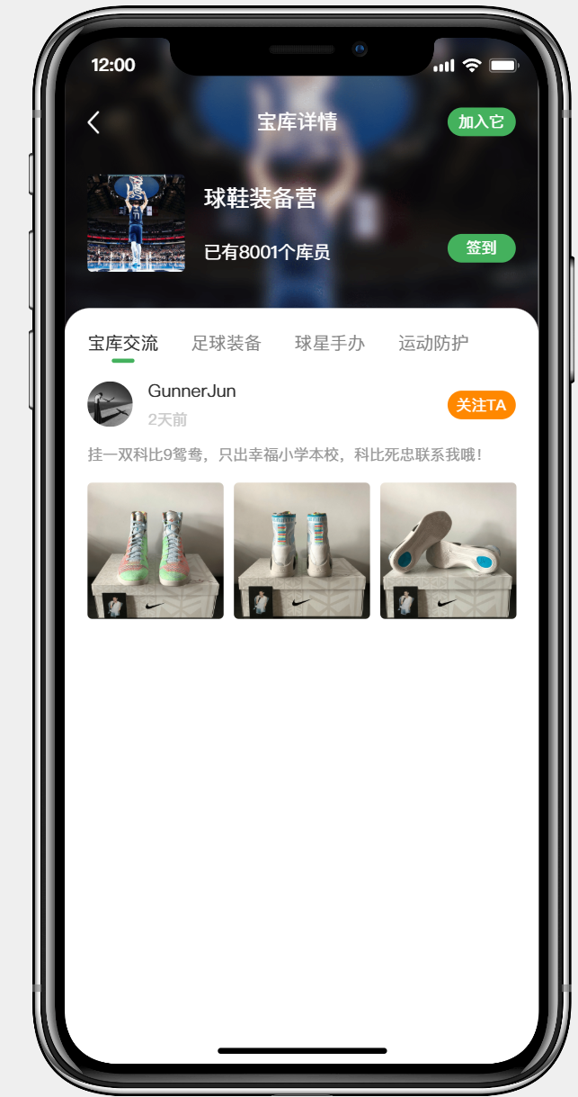
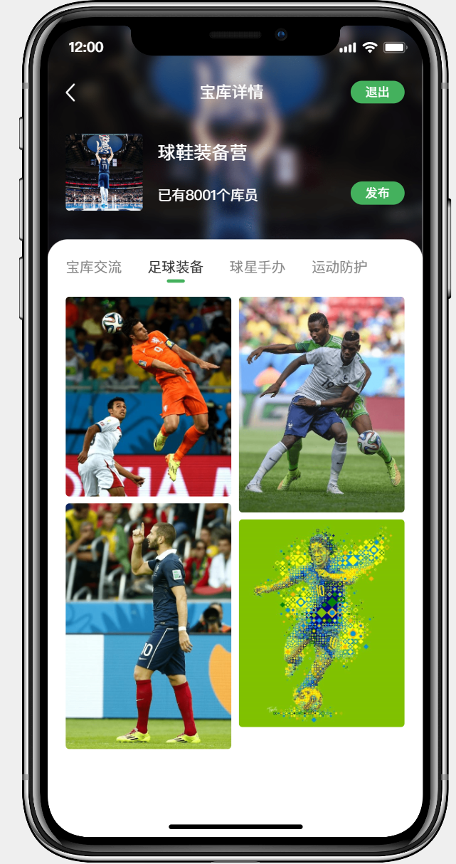
04
Function Desmonstration
Treasure Trove​
The "Treasure Trove" is the interest-based community module, core to enhancing user retention. Users join groups based on hobbies for in-depth discussion. This feature successfully expands the utilitarian trading platform into a social community, fostering trust and frequent interaction through shared interests, which in turn stimulates transactions.

Slide 16
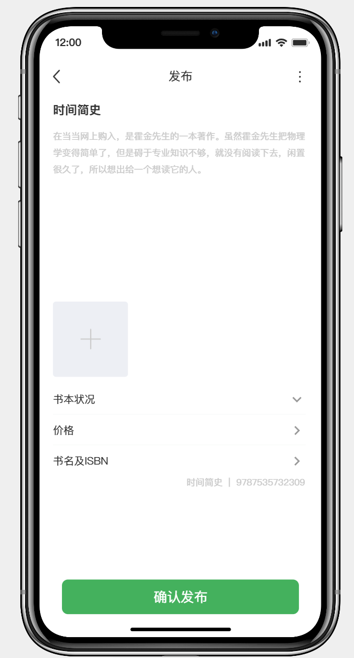
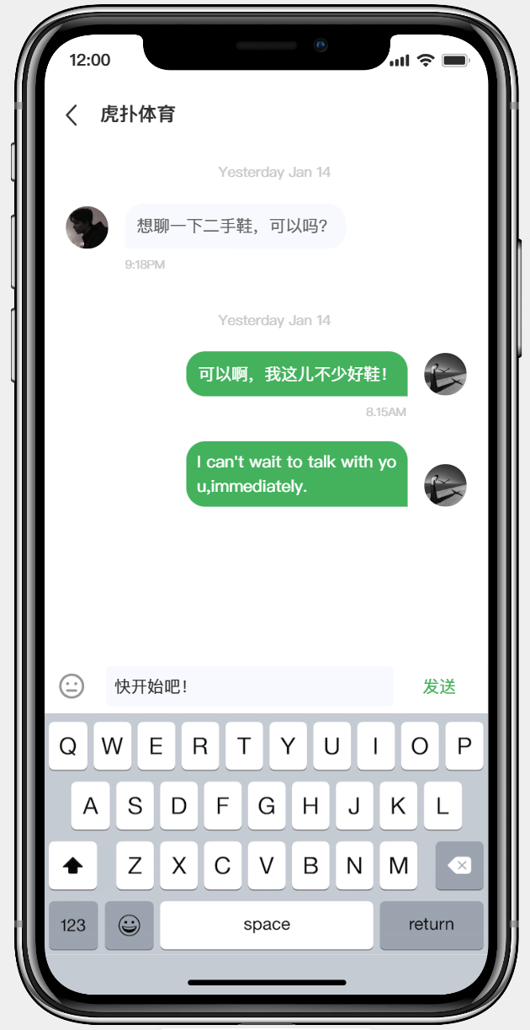
04
Function Desmonstration
Product Listing and Messaging
This slide demonstrates the closed-loop experience from "Listing a Product" to "Communication." The left publish page has a clear structure guiding users to provide standardized item info. The right messaging interface is a key tool for building trust and closing deals. Together, they reflect the platform's seamless integration of the complete user journey: list, communicate, and transact.

Slide 17
05
Deployment
Evaluation Goals and Principal
To comprehensively and fairly reflect each member’s actual contribution and engagement in the project.
To identify team strengths and weaknesses for future improvement and motivation.
To encourage personal development and enhance overall team performance through constructive feedback.
Fairness: Focus on task quality and workload balance, minimizing subjective bias.
Transparency: Make evaluation criteria and procedures open and traceable to all members.
Criterion | Description
Technical Contribution | Code quality, module implementation, problem-solving, and innovation capability.
Collaboration & Communication | Teamwork attitude, coordination, and efficiency in sharing information.
Initiative & Responsibility | Task completion, time management, and commitment to project progress.
Documentation & Presentation | Quality and clarity of written reports, documentation, and presentation preparation.
Improvement & Learning | Willingness to accept feedback, ability to learn, and continuous improvement.

Slide 18
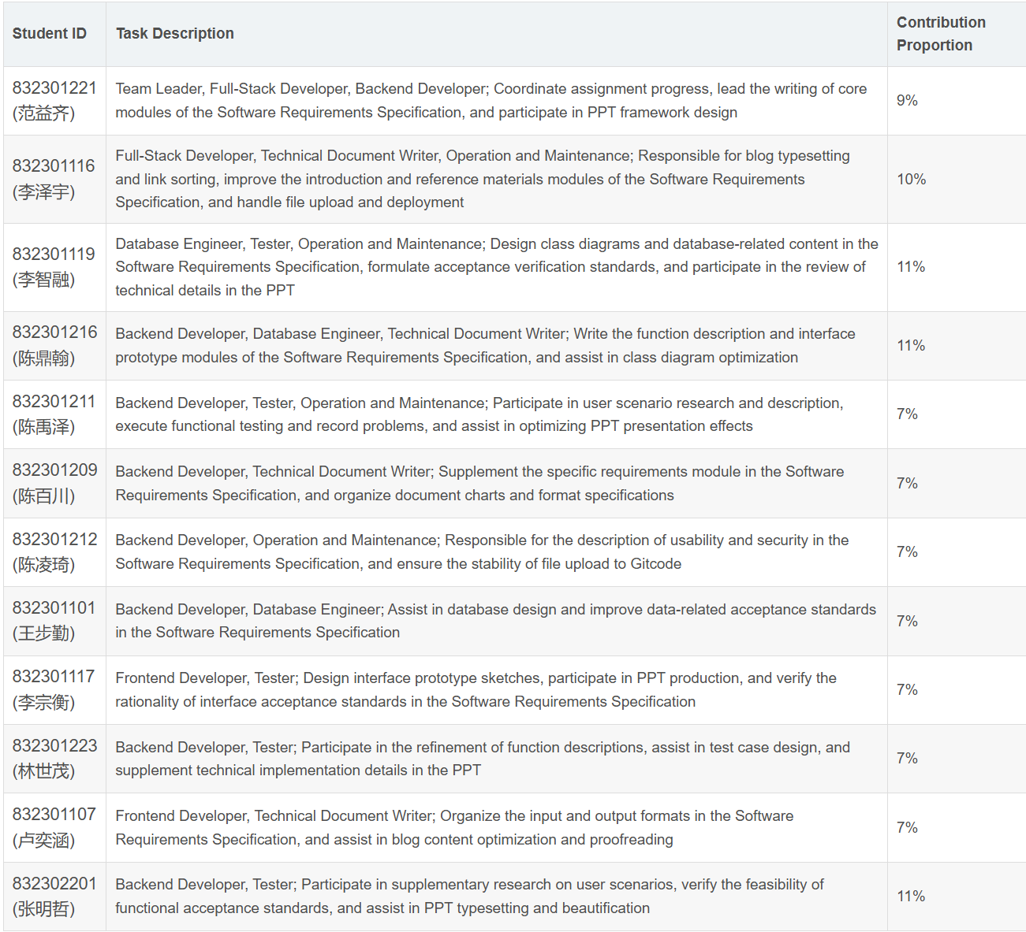
05
Deployment
Evaluation Goals and Principal
To comprehensively and fairly reflect each member’s actual contribution and engagement in the project.
To identify team strengths and weaknesses for future improvement and motivation.
To encourage personal development and enhance overall team performance through constructive feedback.
Fairness: Focus on task quality and workload balance, minimizing subjective bias.
Transparency: Make evaluation criteria and procedures open and traceable to all members.

Slide 19
NEW LIFE TO THE
—— FUTURE
Thanks！
Group:overload
Course：EE308FZ
2025/10/29
NEW PRODUCT LAUNCH

